Slide 1
Board games extravaganza
Kornel Krysiak & Michał Szłański

Slide 2
First, few words on the dataset
17 000 board games from Board Game Geek.
All have > 30 reviews.
Also: 13 000 000 reviews, each with a number and optionally a comment.
Source: https://www.kaggle.com/jvanelteren/boardgamegeek-reviews
Collected in 2019.

Slide 3
Let’s see the data.

Slide 4
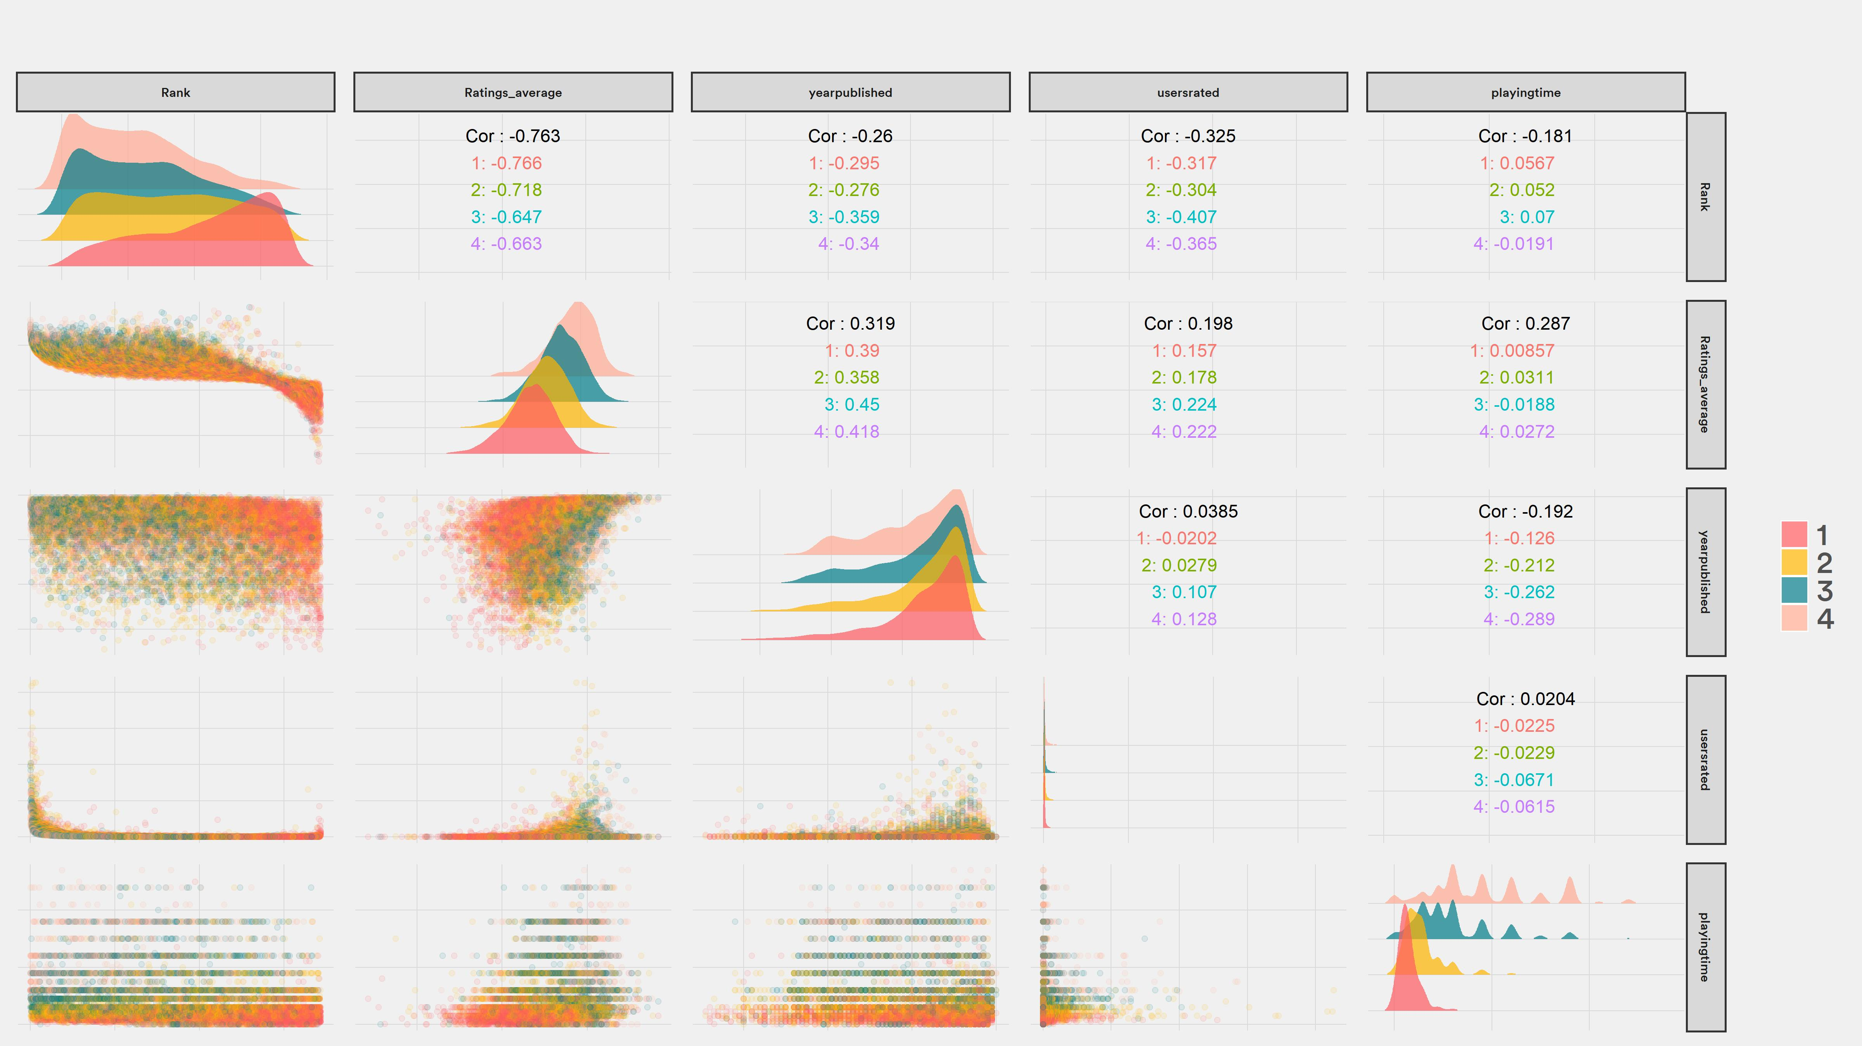

Slide 5
Interesting.

Slide 6
Are there more games each year?

Slide 7
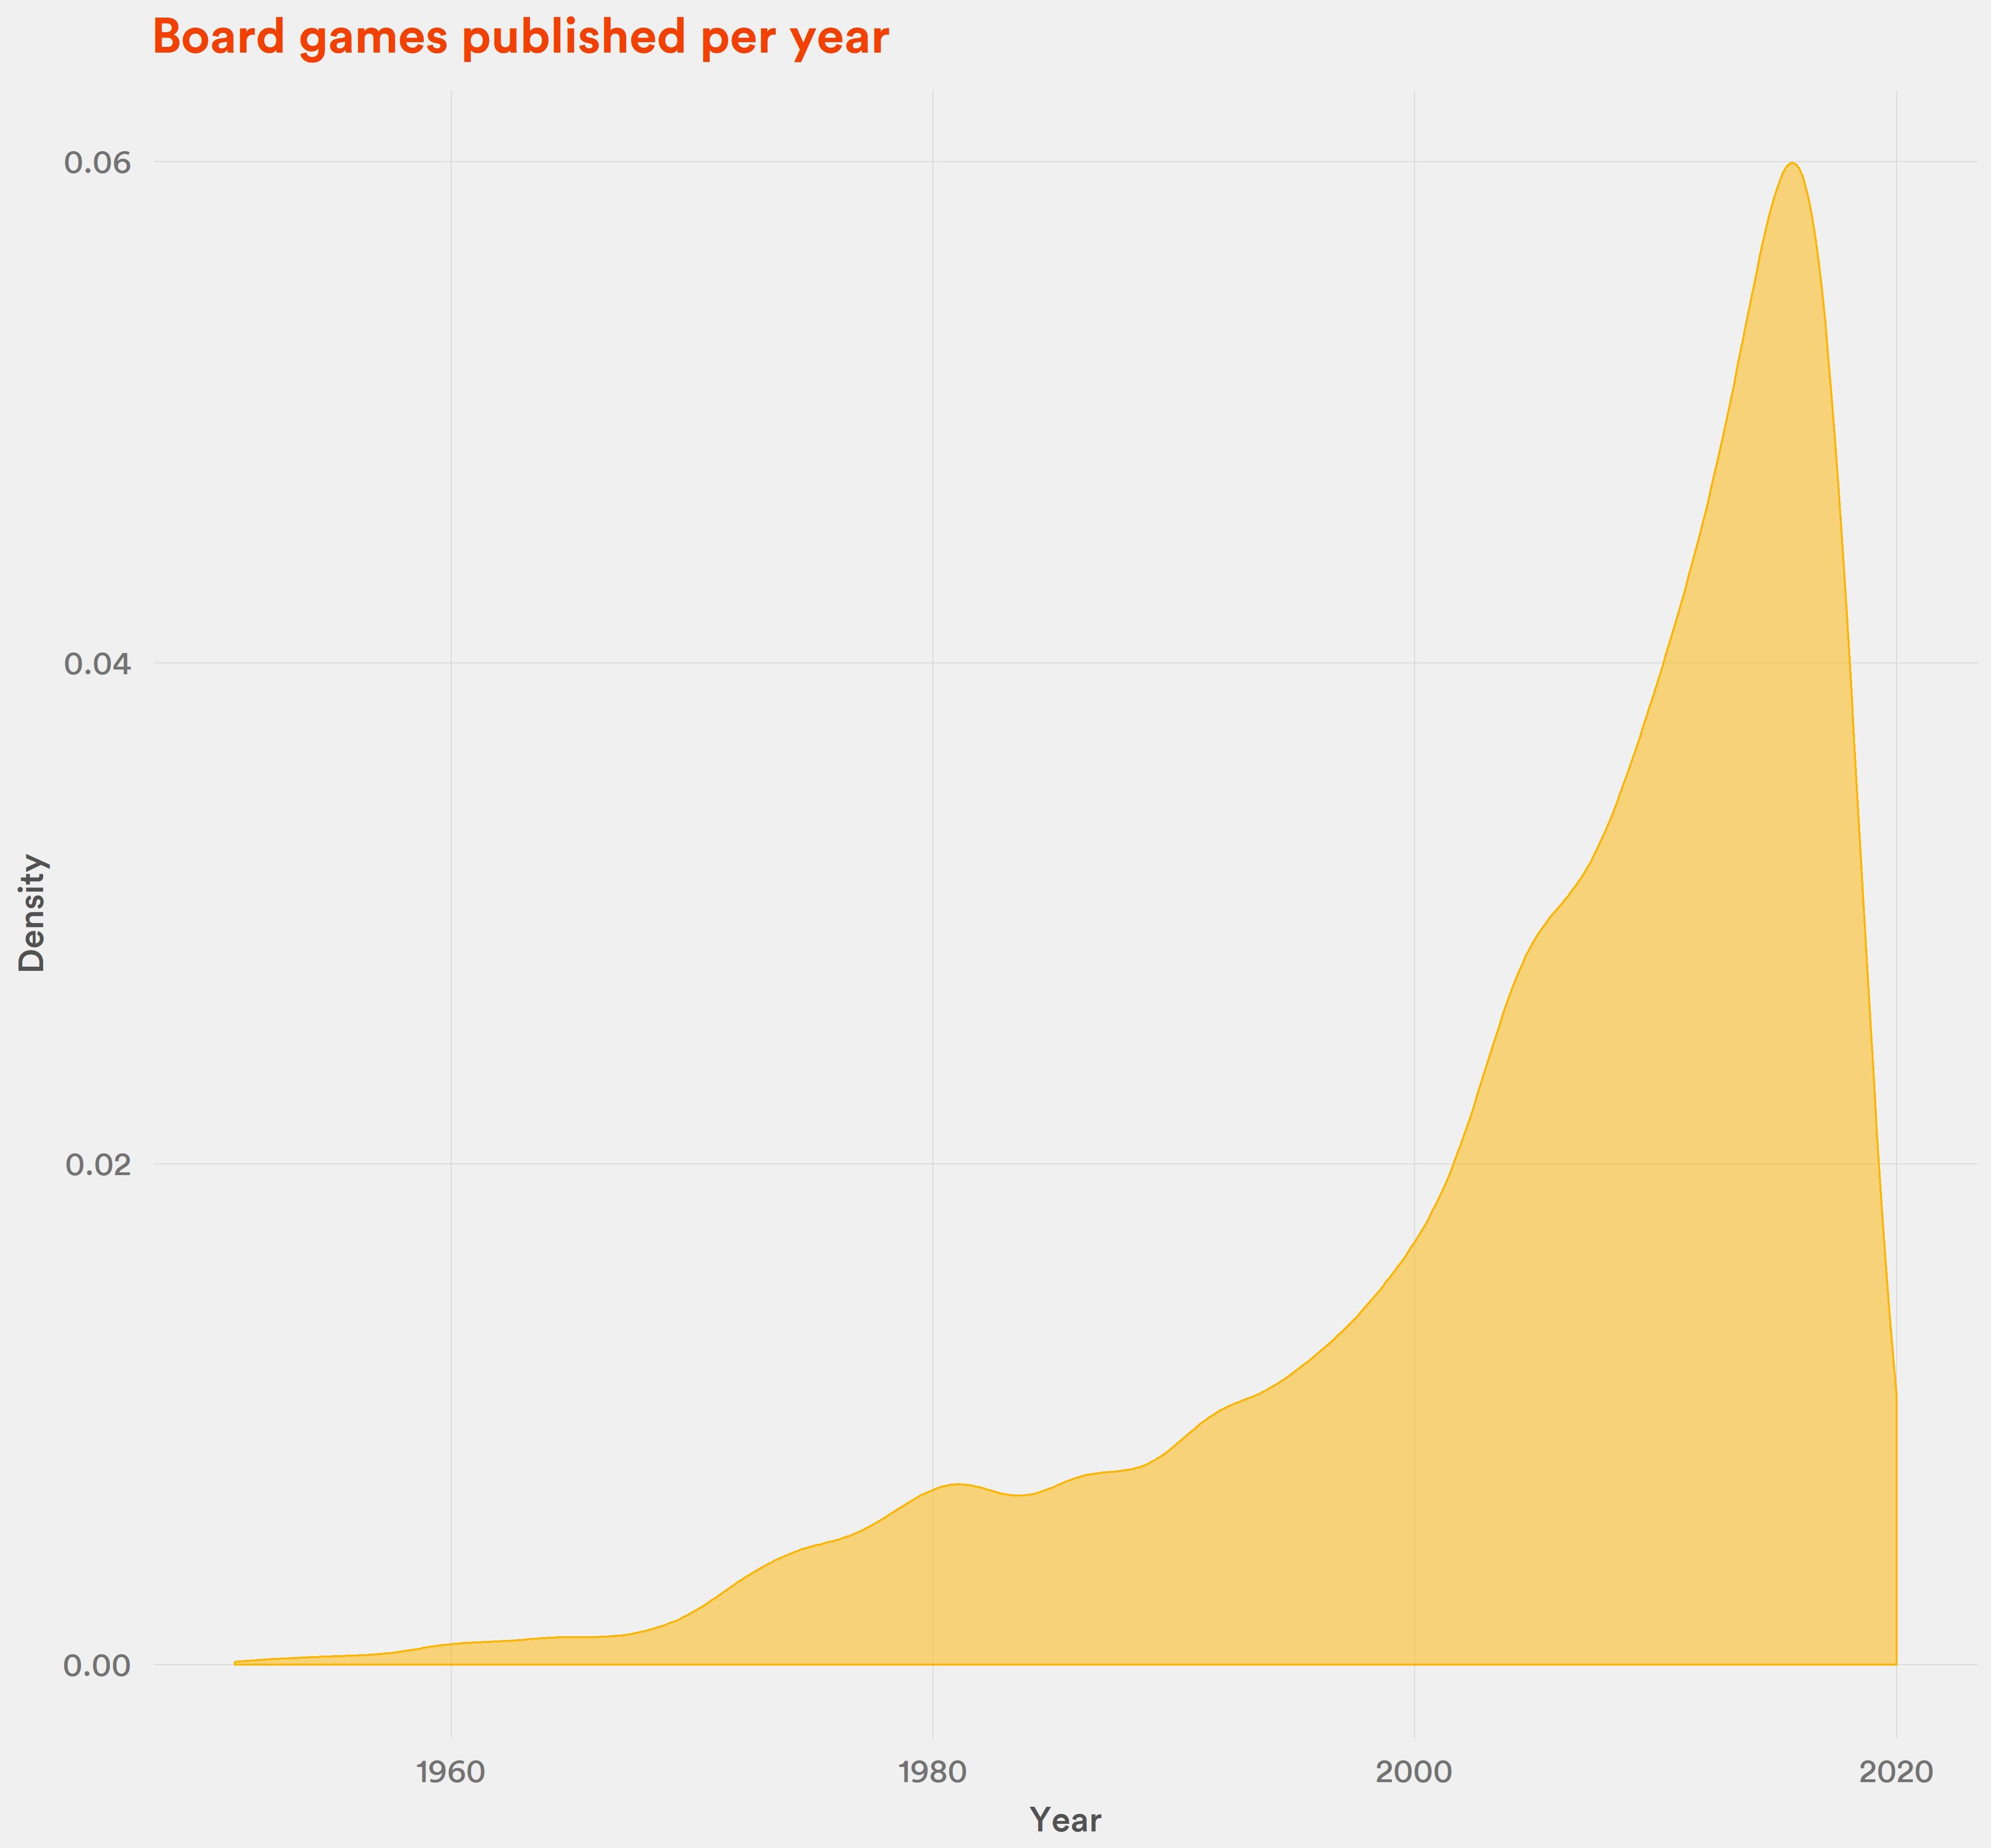
Definitely.
Compared to 2000, the number of games published in 2019 nearly tripled.

Slide 8
But, are they getting better?

Slide 10
It looks like there is some positive effect for games that came out max 3-4 years ago. Also, notice the preorder hype.

Slide 11
Board Game Geek is quite a „nerdy” place. Do less complex, „party” games get lower scores?

Slide 12
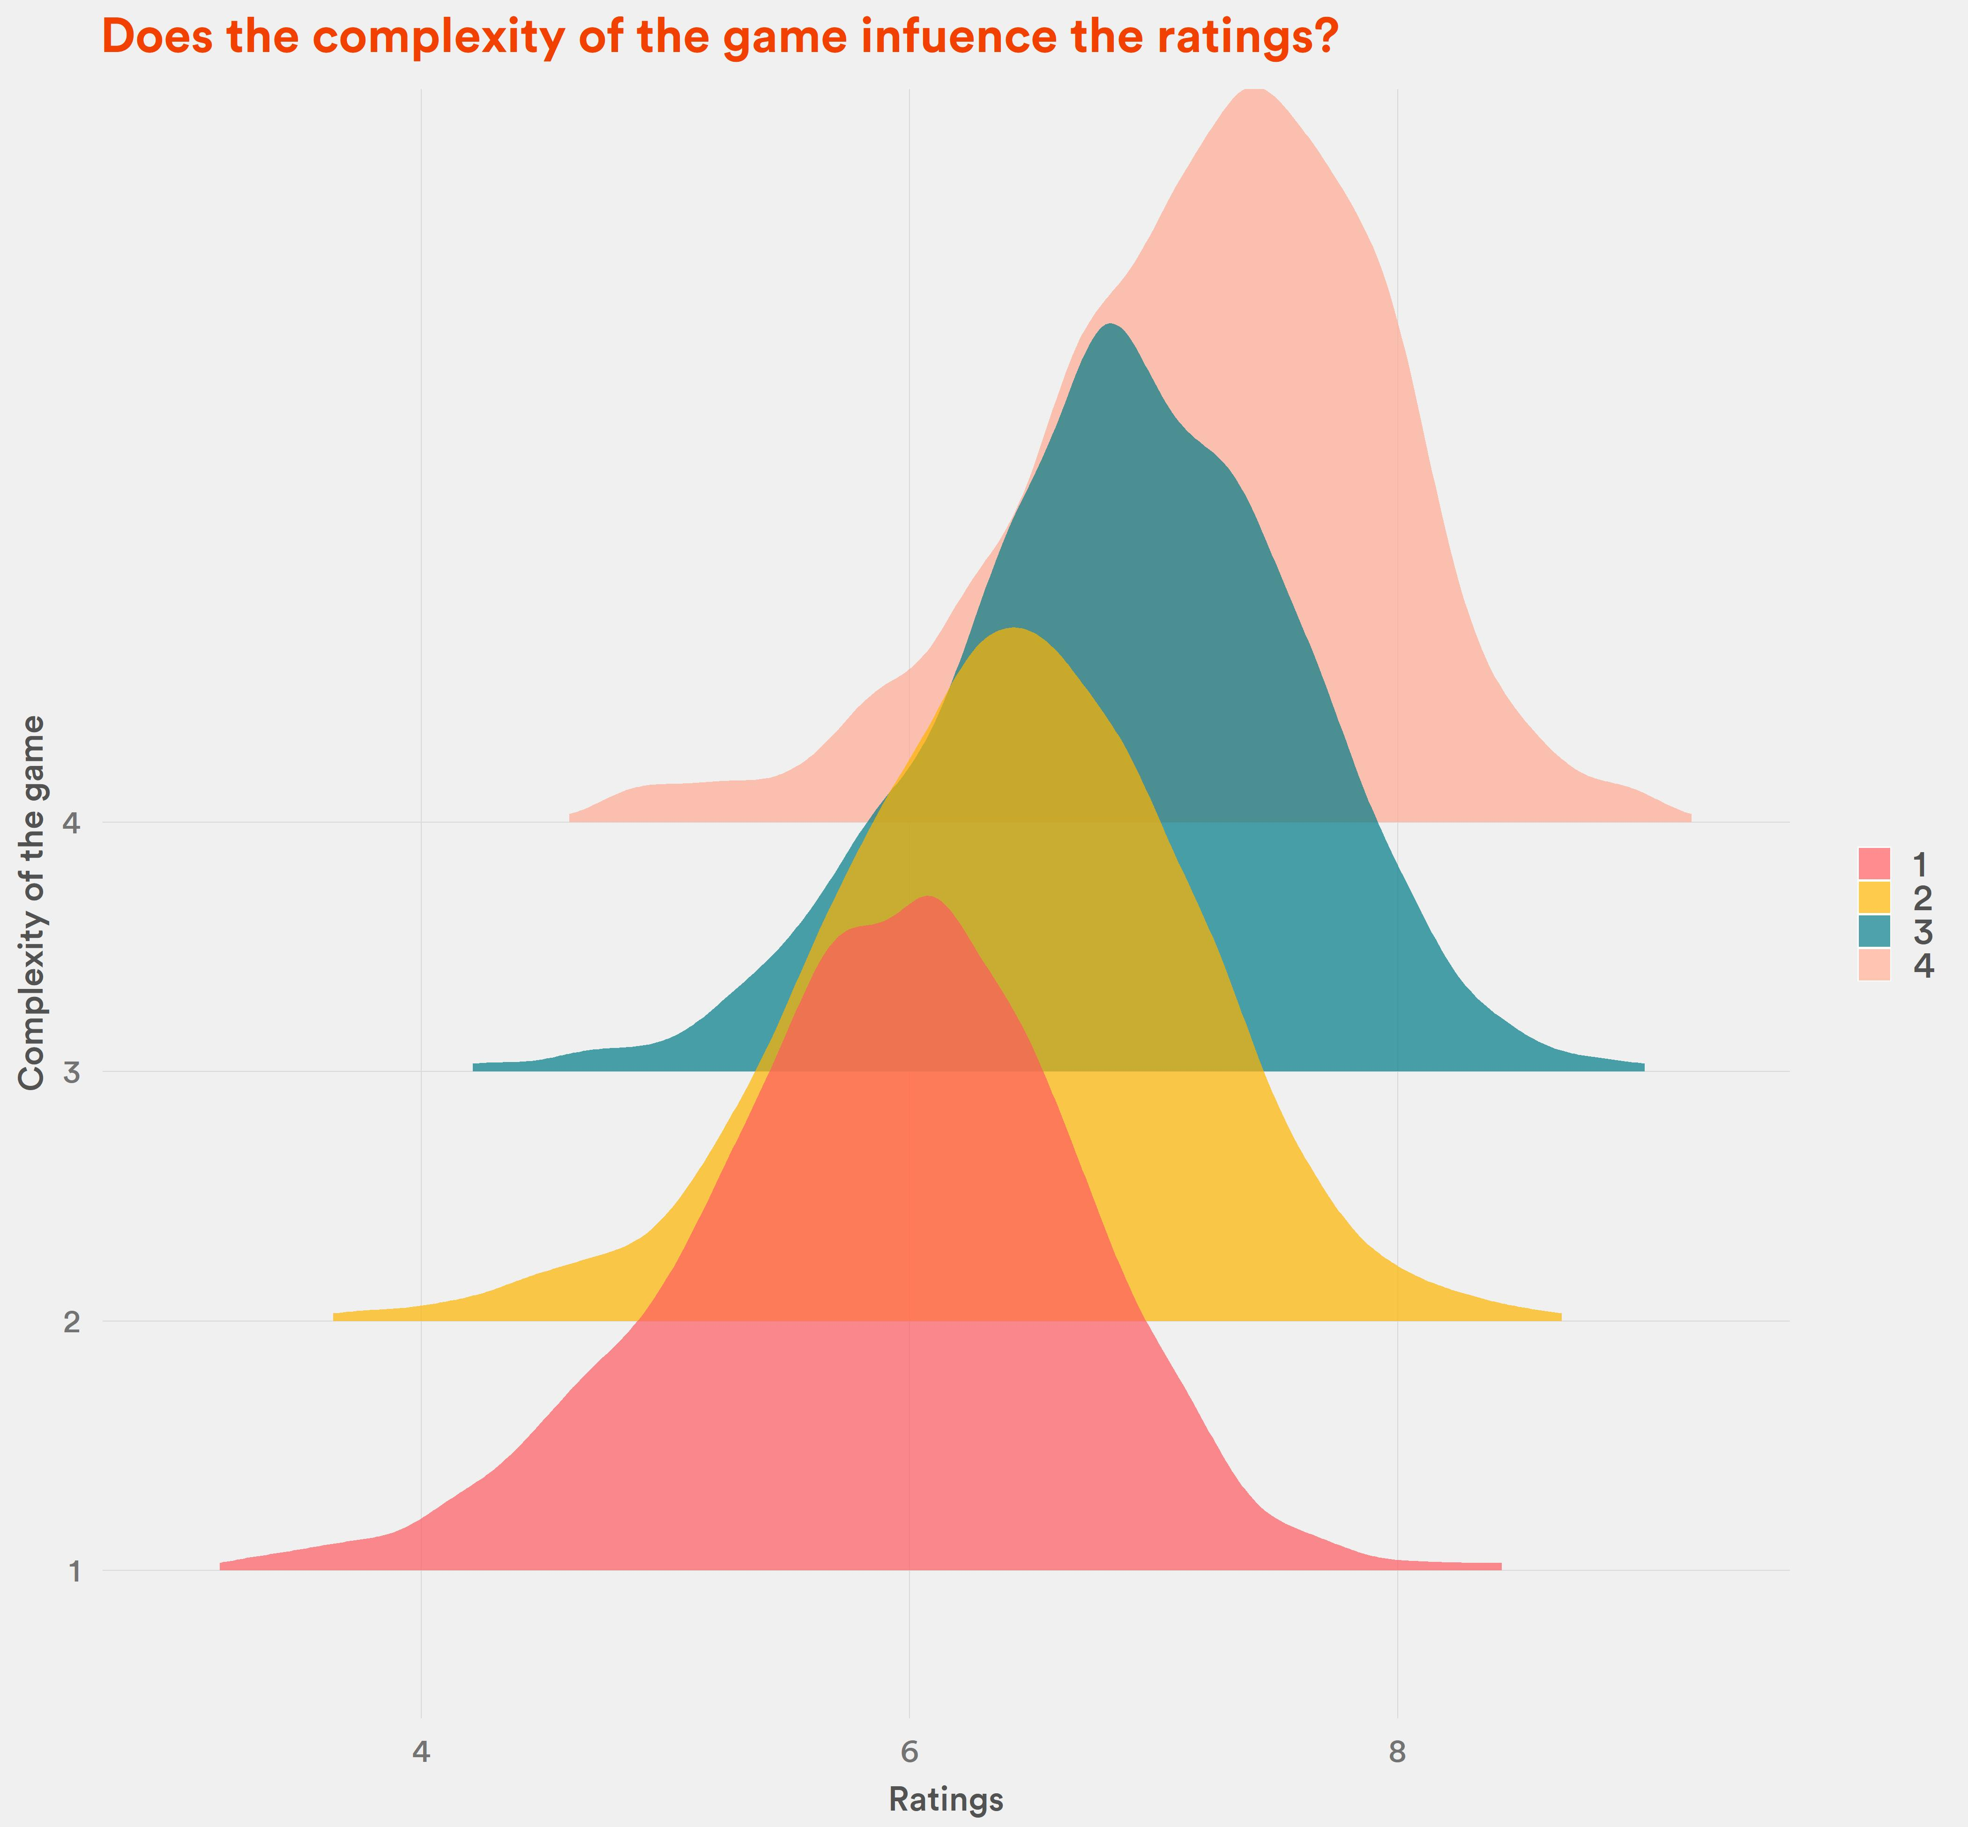
Yes.
Simple games are rated at around 6.
The complex games: at 7.5

Slide 13
How exactly is the rank calculated? Does average rating and number of reviews matter?

Slide 14
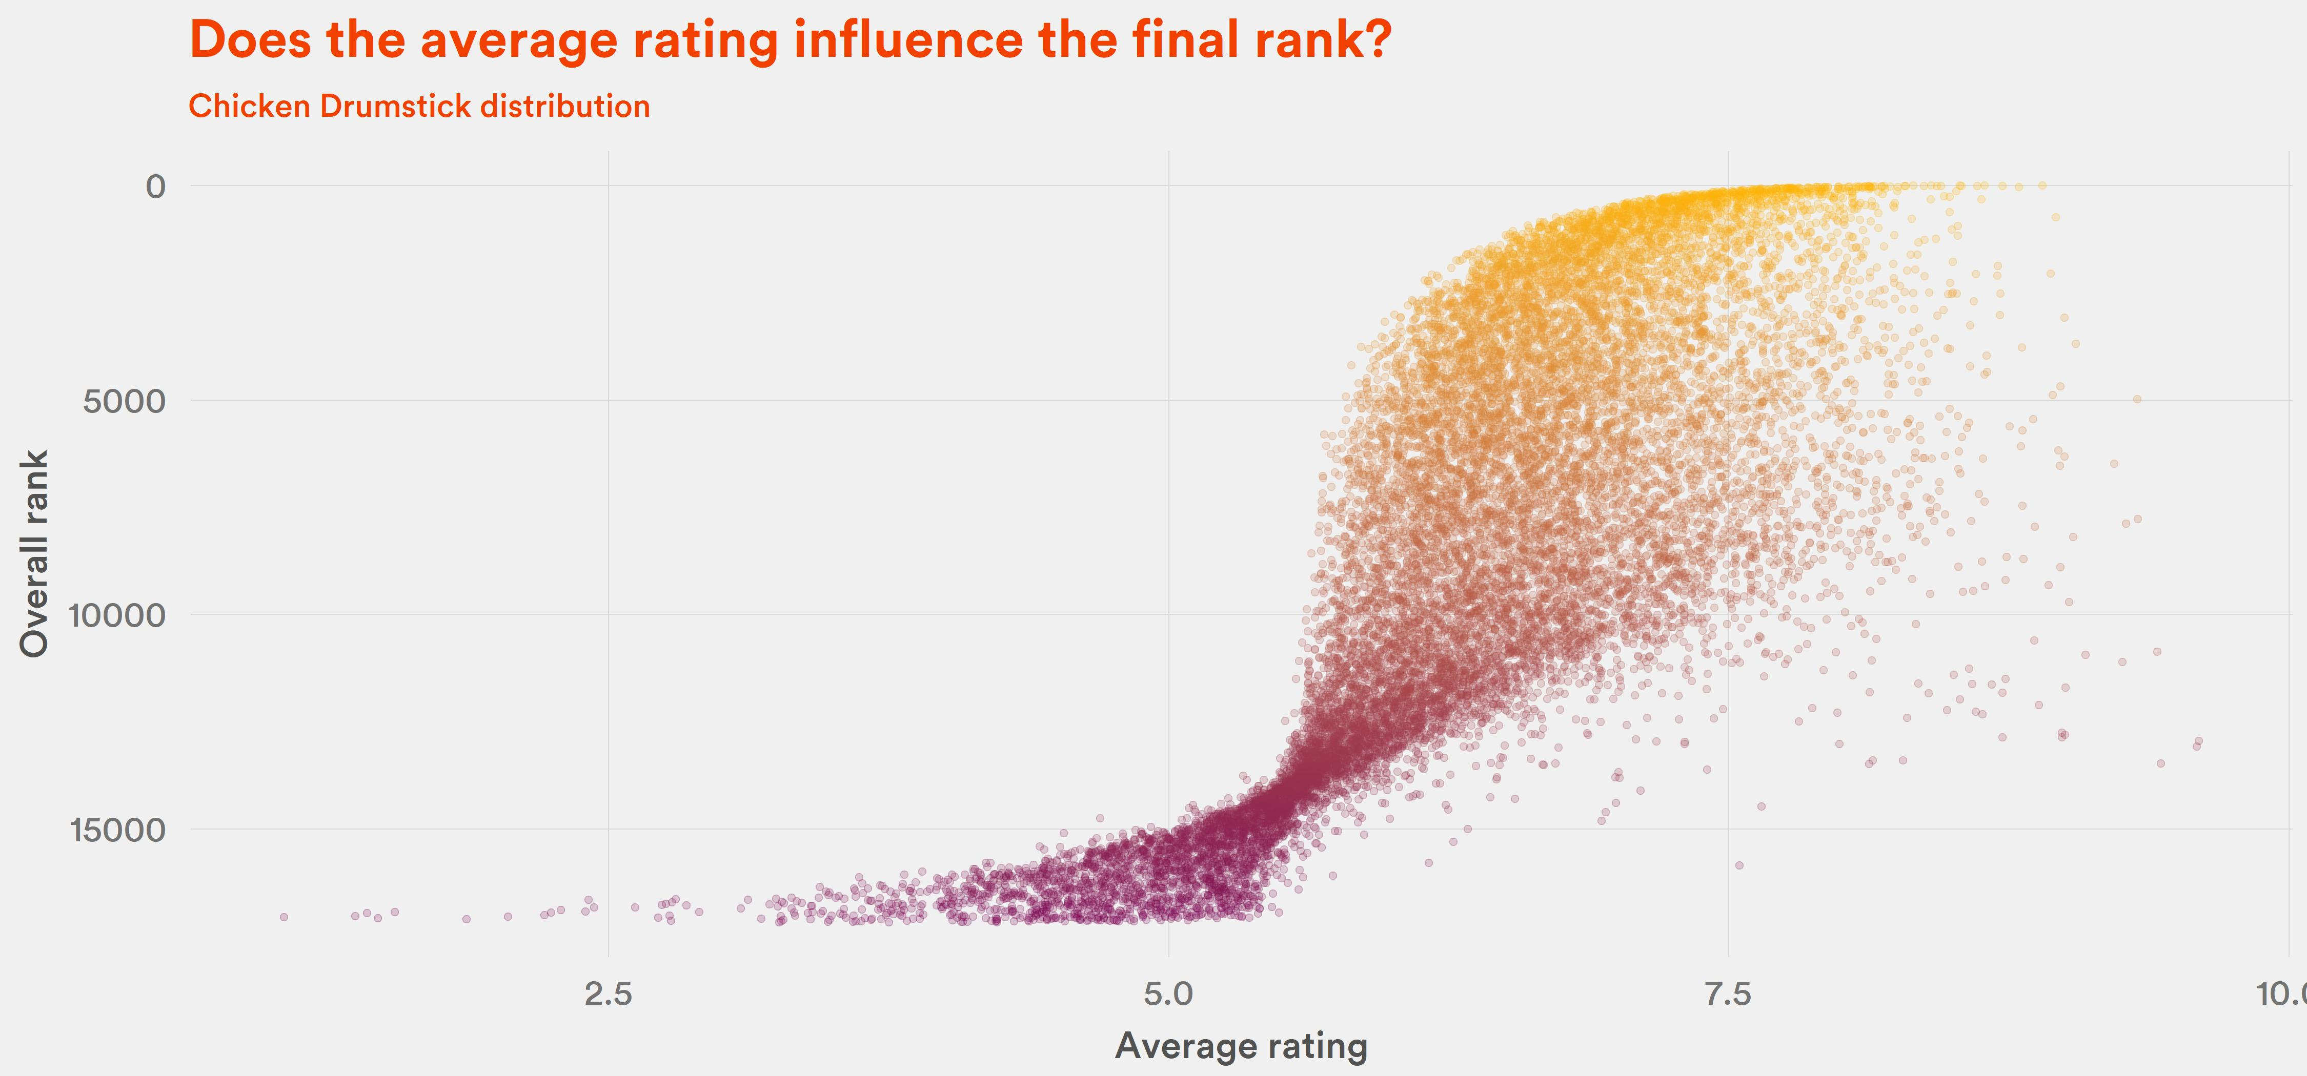
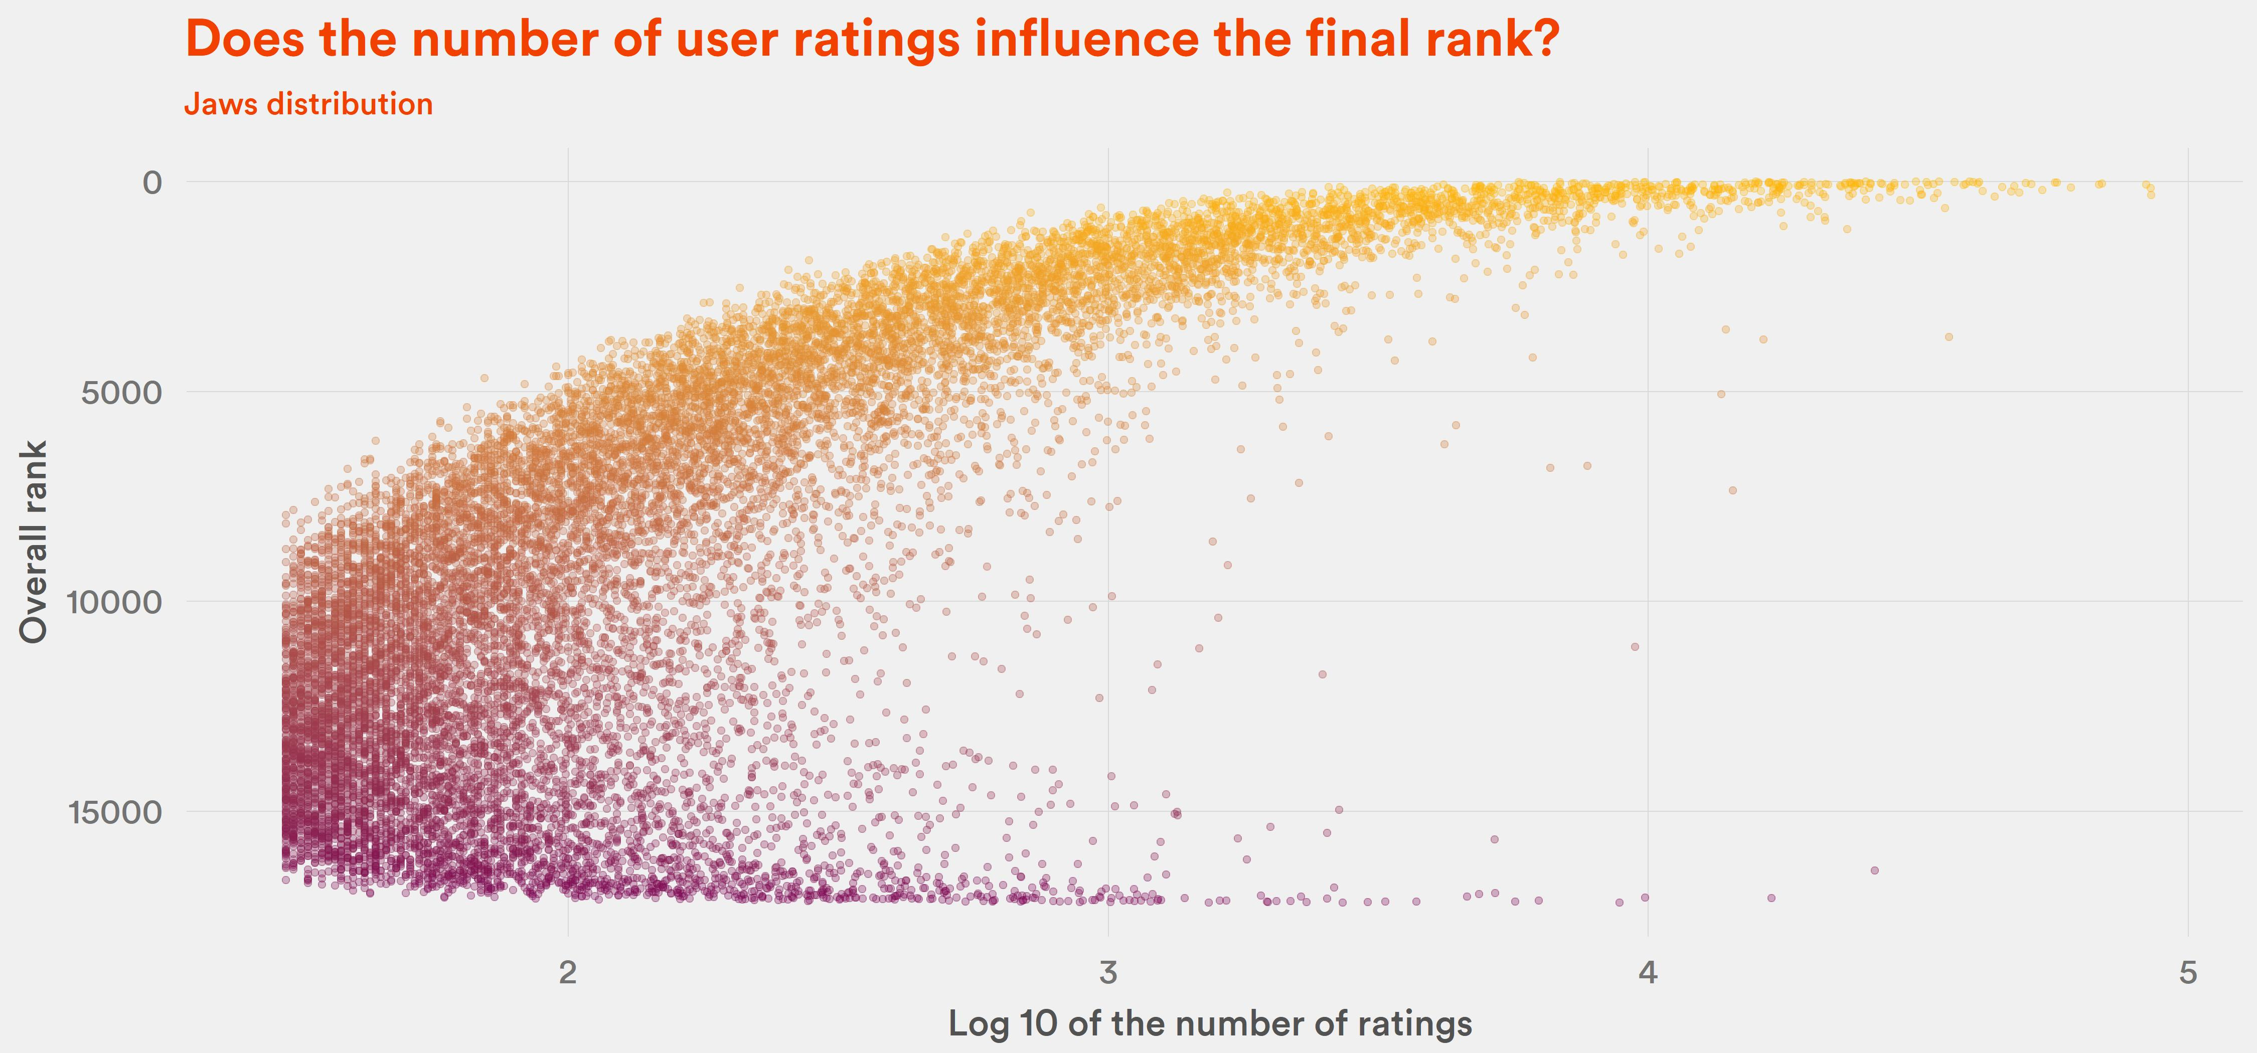
Yes, but not in a straightforward way.

